Slide 1
Computer Hardware

Slide 2
Computer Hardware Overview
The Basics When Purchasing
Motherboard
Microprocessor
Computer Memory (RAM)
Hard Disk Drive
CD Drives
Floppy Drive
Video Card
Monitor
Modem
Network Devices
Additional Purchasing Decisions
Printers
Air Conditioner
UPS
RAID Devices

Slide 3
Motherboard
The Motherboard
The mother for your:
- Microprocessor Chip or Chips
- Memory Chips
- For the other internal components that enable your system to function
Can be detrimental to:
- Overall Microprocessor speed
- Scalability

Slide 4
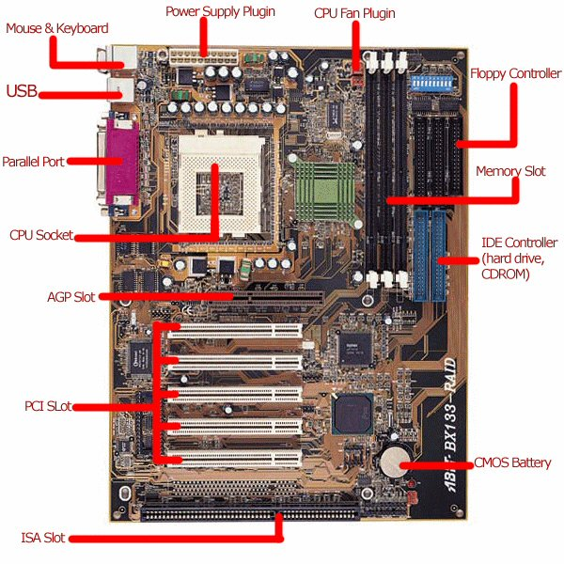
Motherboard
The Motherboard
PCI Slots –
(Peripheral Component Interconnect)
Normally used for other devices
Such as a sound card, modem, or a network interface card. operates at 33MHz and has a maximum bandwidth of 133MB/s.
ISA Slots –
(Industry Standard Architecture )
Not used very often with modern Motherboards. The PCI Bus was its replacement. operates at 16MHz and has a maximum bandwidth of 16MB/s.
CMOS –
used to store important system information and configuration settings while the computer is off and on.

Slide 5
Microprocessors: The Main Engine
The Microprocessor
Buried somewhere on that big motherboard is a specific chip that controls your entire computer system.
This chip is called a microprocessor or a central processing unit (CPU).
The Microprocessor is responsible for:
- processes all the instructions necessary for your computer to perform its duties
- running the computer system with speed and efficiency

Slide 6
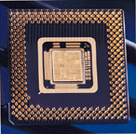
Microprocessors: Tech Specs
The Microprocessor
- CPU speed is measured in megahertz (MHz)
- Shopping for a new PC, look for one with the combination of a powerful
microprocessor and a high clock speed for best performance.
- Today's fastest chips are actually measured in gigahertz (GHz)
How fast is 1 Gigahertz?
1000 MHZ, or one billion cycles per second!

Slide 7
Microprocessors: Tech Specs
Many confusing specifications often are quoted in discussions of processors
Specifications may include but are not limited to:
- data bus
- speed
Processors can be identified by two main parameters: how wide they are and how fast they are
Data Bus
This defines the rate at which data can be moved into or out of the processor
Speed
Refers to the clock speed of the Microprocessor in MHz or GHz
Additional Term:
HT – Stands for Hyper Threading Technology

Slide 8
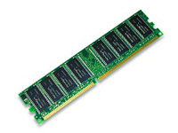
Computer Memory: (RAM)
Before your CPU can process any instructions you give it, those instructions must be stored somewhere, in preparation for access by the microprocessor
- The more memory that is available in a machine, the more instructions and data
that can be stored at one time.
- If the computer does not have enough RAM to run an application than pieces of
the running application will be stored on the Hard Drive temporarily in a method
known as “Virtual Memory” and the CPU will then have to retrieve information
from the virtual memory causing a bottleneck in the system.
RAM is measured in bytes:
For example, a computer with 256MB RAM has approximately 256 million bytes of memory that programs can use.

Slide 9
Computer Memory: (RAM)
RAM Types:
DRAM - Pronounced dee-ram, DRAM stands for dynamic random access memory, a type of memory used in most personal computers.
SDRAM - Short for Synchronous DRAM, a type of DRAM that can run at much higher clock speeds than conventional memory. SDRAM actually synchronizes itself with the CPU's bus and is capable of running at 133 MHz, about three times faster than conventional RAM
DDR SDRAM - Short for Double Data Rate-Synchronous DRAM, a type of SDRAM that supports data transfers on both edges of each clock cycle (the rising and falling edges), effectively doubling the memory chip's data throughput. DDR-SDRAM also consumes less power
Additional Terms:
DIMM - Short for dual in-line memory module, DIMM has 64-bit path. The Pentium processor requires a 64-bit path to memory thus you can install DIMMs one or two at a time if you wish.
SIMM - Short for single in-line memory module, SIMM has 32-bit path. You must install SIMMs two at a time to stay consistent with 64 bits.

Slide 10
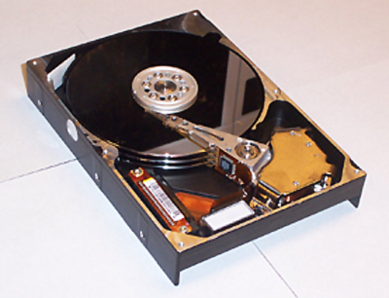
Hard Disk Drives: Long-Term Storage
The hard disk permanently stores all your important data. Some hard disks can store more than 100 gigabytes of data.
RPM – Determines how fast your Hard Drive will access data.
Revolutions Per Minute.
Typical RPM Values:
Desktop Machine – 7,200 RPM
Laptop Machines – 5,000 RPM
Server Machines – 10,000 RPM

Slide 11
Hard Disk Drives: Long-Term Storage
Additional Terms:
ATA – Advanced Technology Attachment
Serial ATA - an evolution of the Parallel ATA physical storage interface. Transfer rates for Serial ATA begin at 150MBps.
SCSI - Short for small computer system interface. Pronounced "scuzzy," SCSI is a parallel interface standard used by Apple Macintosh computers, PCs, and many UNIX systems for attaching peripheral devices to computers.
SCSI Devices offer the following benefits:
- SCSI interfaces provide for faster data transmission rates (up to 80
megabytes per second) than standard serial and parallel ports.
- You can attach many devices to a single SCSI port, so that SCSI is really an
I/O bus rather than simply an interface

Slide 12
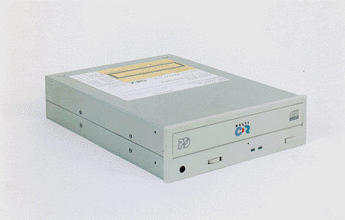
CD Drives
Information on a CD-ROM is encoded in the form of microscopic pits (representing the 1s and 0s of computer binary language) below the disc's surface.
- Multiples of 150kb per second so 24x is writing at 3600kb per second or 3.6
MB per second.

Slide 13
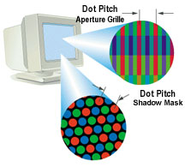
Monitors
Operating a computer would be difficult if you didn't constantly receive visual feedback showing you what your machine is doing. This vital function is provided by your computer's monitor.
DP (dot pitch) - Also called phosphor pitch, a measurement that indicates the diagonal distance between like-colored phosphor dots on a display screen.
- the dot pitch is one of the principal characteristics that determine the quality of
display monitors.
- The lower the number, the crisper the image. The dot pitch of color monitors
for personal computers ranges from about 0.15 mm to 0.30 mm
Additional Terms:
CRT – Cathode Ray Tube, the technology used in most televisions
LCD – Liquid Crystal Display, a type of display used in digital watches and many portable computers

Slide 14
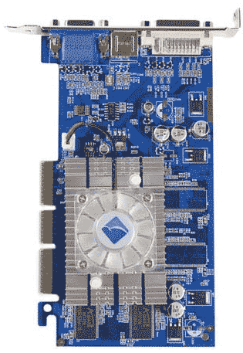
Video Cards
A board that plugs into a personal computer AGP Port on the motherboard to give it display capabilities.
- Modern video adapters contain memory, so that the computer's RAM is not used
for storing displays.
- Modern adapters have their own graphics
coprocessor for performing graphics
calculations. These adapters are often called
graphics accelerators.

Slide 15
Modems: Getting Connected
Almost all PC systems today include a modem. A modem enables your computer to connect to a telephone or cable line and transmit data to and from the Internet.
- Modems come in either internal (card-based) or external models that hook up to
an open port on the back of your system.
The following characteristics distinguish one modem from another:
bps - How fast the modem can transmit and receive data. The fastest modems run at 57,600 bps.
voice/data - Many modems support a switch to change between voice and data modes. In data mode, the modem acts like a regular modem. In voice mode, the modem acts like a regular telephone.
data compression - Some modems perform data compression, which enables them to send data at faster rates.
Fax capability - Most modern modems are fax modems, which means that they can send and receive faxes

Slide 16
NIC
The most common type of network is a wired network using Ethernet cables and hardware. For this type of network, you need to install and configure a network interface card (NIC) in each of your PCs.

Slide 17
Printers
3 Selling Points:
* All in one features (i.e. scanning, printing, faxing)
* Standalone capabilities
* Resolution
Resolution - Refers to the sharpness and clarity of an image. 300dpi (dots per inch) For example, a 300-dpi (dots per inch) printer is one that is capable of printing 300 distinct dots in a line 1 inch long. This means it can print 90,000 dots per square inch.
Screen Resolution - the screen resolution signifies the number of dots (pixels) on the entire screen. For example, a 640-by-480 pixel screen is capable of displaying 640 distinct dots on each of 480 lines, or about 300,000 pixels.
PPM (Page Per Minute) - Stands for pages per minute and is used to measure the speed of certain types of printers Also take note that typically this measurement is for Text and NOT graphics.

Slide 18
Air Conditioner
Keep the equipment cool!
- look at the BTU readings, in most situations at least 5,000 BTU is required

Slide 19
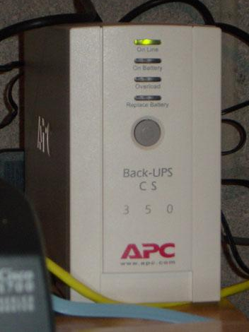
UPS
uninterruptible power supply, a power supply that includes a battery to maintain power in the event of a power outage.
Typically, a UPS keeps a computer running for several minutes after a power outage, enabling you to save data that is in RAM and shut down the computer gracefully
There are two basic types of UPS:
- standby power systems (SPSs) - SPS monitors the power line and switches to battery power as soon as it detects a problem.
- on-line UPS systems – provides constant power from its own converter.

Slide 20
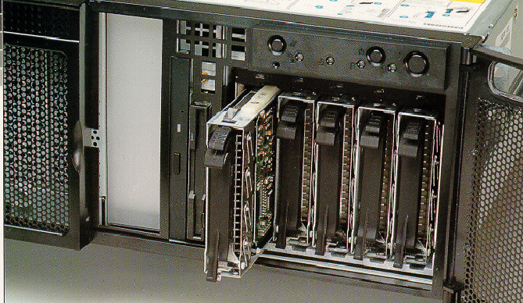
RAID Devices
A category of disk drives that employ two or more drives in combination for fault tolerance and performance. RAID disk drives are used frequently on servers but aren't generally necessary for personal computers.
- There are number of different RAID levels. The three most common are 0 and 5
0 - Provides data striping (spreading out blocks of each file across multiple disks) but no redundancy. This improves performance but does not deliver fault tolerance.
5 - Provides data striping at the byte level and also stripe error correction information. This results in excellent performance and good fault tolerance.

